Slide 1
Selected topics 1
Python
Dr: Nashwa Nageh

Slide 2
Agenda
String Methods
String formatting
Number
Arithmetic Operators
List

Slide 3
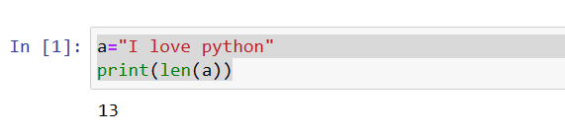
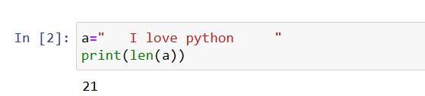
String Methods (part2)
The len() function returns the number of items in an object.
When the object is a string, the len() function returns the number of characters in the string.
Space consider as char

Slide 4
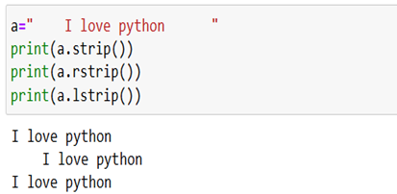
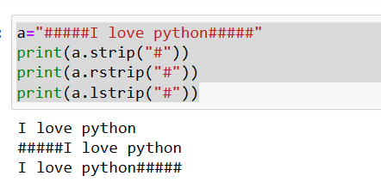
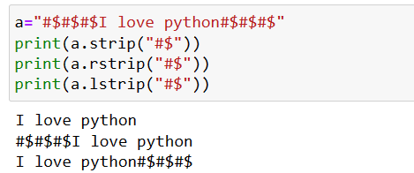
String Methods (part2)
Ex1:
Ex1:
strip: Remove spaces at the beginning and at the end of the string
rstrip: Remove spaces at the right
lstrip: Remove spaces at the left
You can specify which character(s) to remove, if not, any whitespaces will be removed.
Ex2:
Ex3:

Slide 5
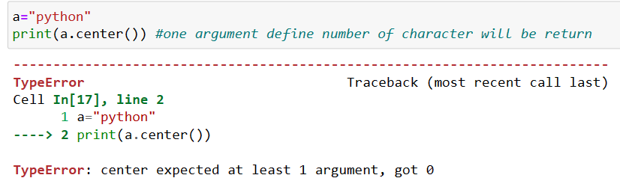
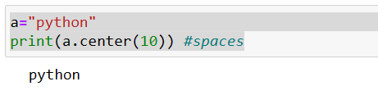
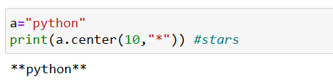
String Methods (part2)
The center() method will center align the string, using a specified character (space is default) as the fill character.
Ex1:
Ex2:
Ex3:

Slide 6
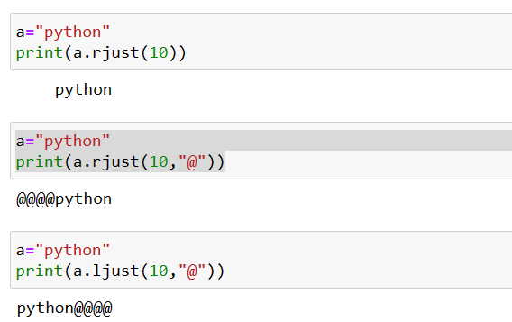
String Methods (part2)
The rjust(), ljust() method will right and left align the string, using a specified character (space is default) as the fill character.
Right space

Slide 7
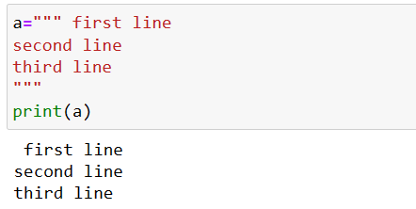
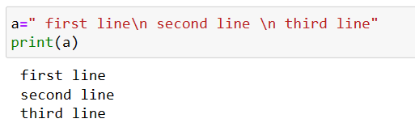
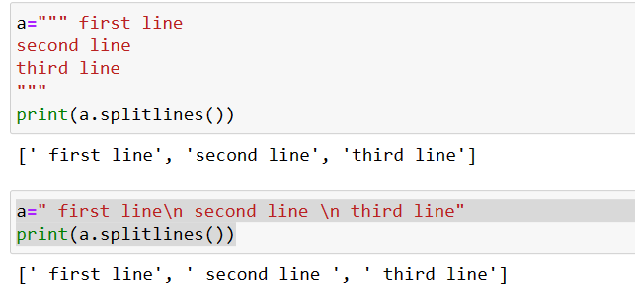
String Methods (part2)
The splitlines() method splits a string into a list. The splitting is done at line breaks.
Write in multiple lines
splitlines() method

Slide 8
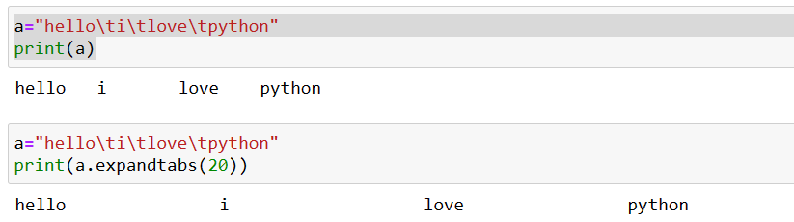
String Methods (part2)
The expandtabs() method sets the tab size to the specified number of whitespaces.
Using \t to take tab
Using expandtabs() method

Slide 9
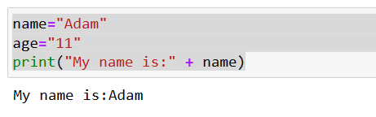
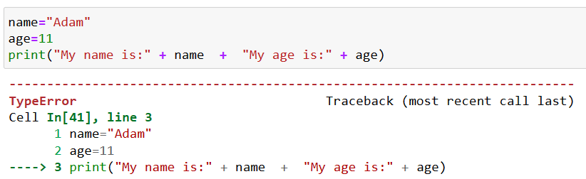
String formatting
concatenation
Type error

Slide 10
String formatting
Placeholders are represented as a character, or a set of characters used after a % symbol.
% represents the placeholder and the following character or set of characters represents the data type of the value that will replace the placeholder.
%d for integers.
%f for float.
%s for strings.

Slide 11
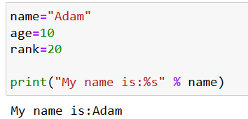
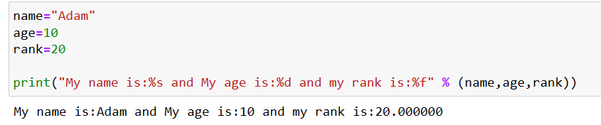
String formatting
print("My name is:%s" % "ahmed")
We can assign specific strings in the placeholder not only varibles

Slide 12
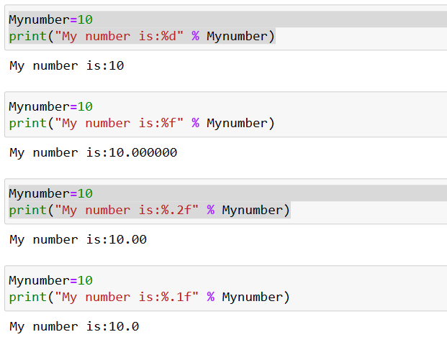
Control floating point number
Print digit variable in placeholder
Print floating point variable in placeholder
Print floating point variable in placeholder and control the floating-point number

Slide 13
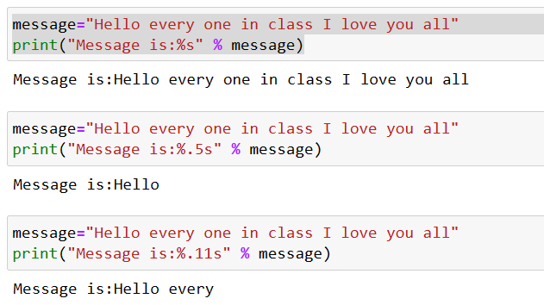
Truncate string
Print string variable in placeholder
Print string variable in placeholder and control the string number

Slide 14
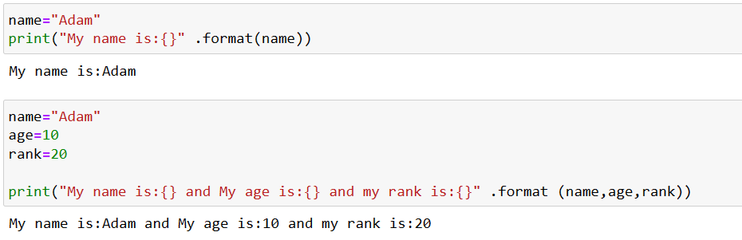
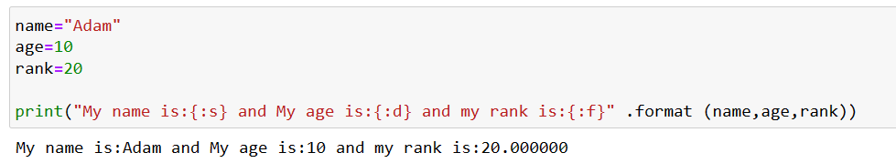
String formatting (new way)

Slide 15
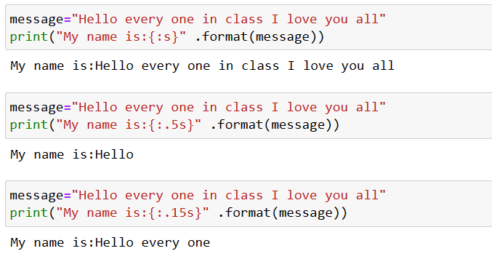
Control string formatting

Slide 16
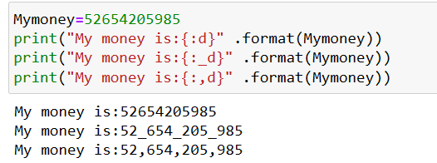
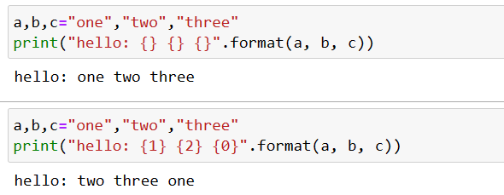
String formatting (new way)
Format Money
Rearrange item
Rearrange item

Slide 17
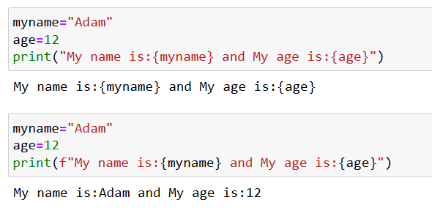
Formatting in version 3.6
Only put the format operator f before code

Slide 18
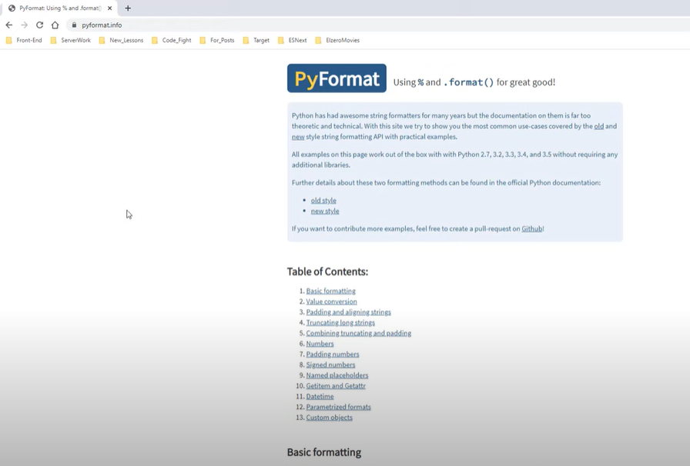
PyFormat web site
Contain a lot of format

Slide 19
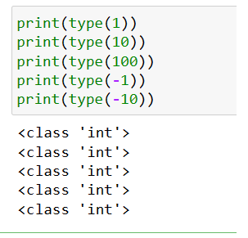
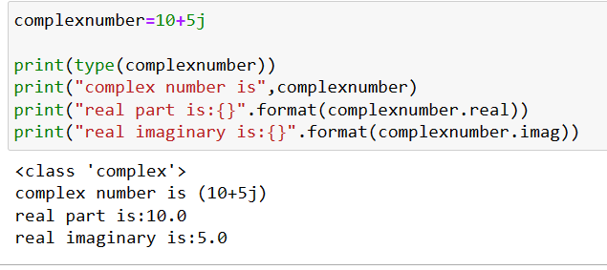
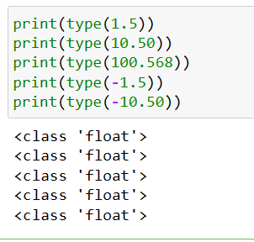
Number
Integer number
complex number
float number

Slide 20
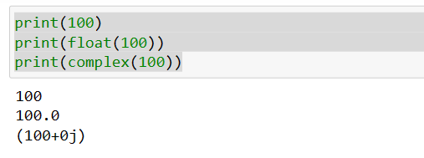
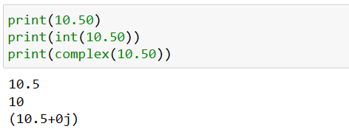
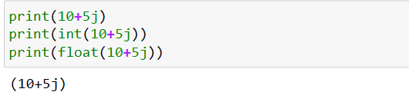
Number
You can convert from int to float or complex
You can convert from float to int or complex
You can’t convert from complex to any type

Slide 21
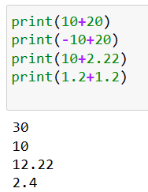
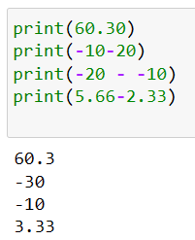
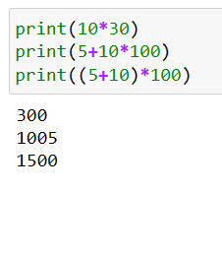
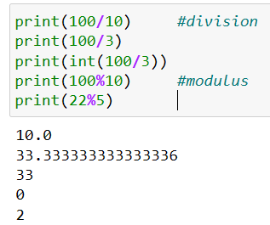
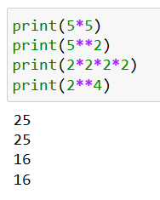
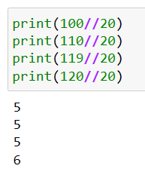
Arithmetic Operators
Addition
Subtraction
Multiplication
Division
Exponent
Floor Division
returns the largest integer less than or equal to x.

Slide 22

List
List
List are enclosed in square bracket
List are ordered, to use index to access item
List are mutable=> Add, Delete, Edit
List items is not unique
List can have different data types

Slide 23
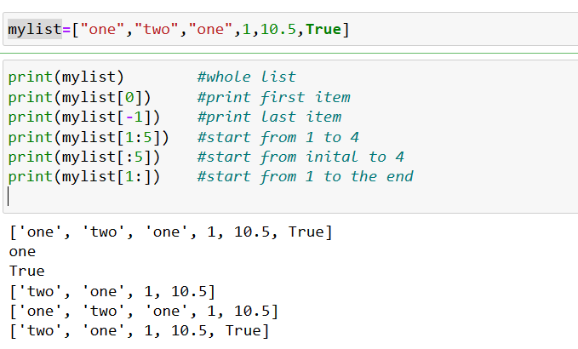
List

Slide 24
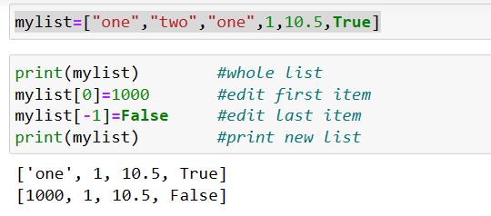
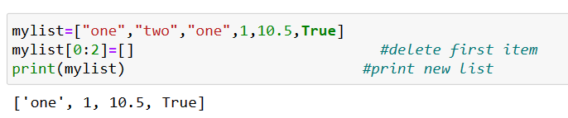
List
List
Edit list item
Delete item from list

Slide 25
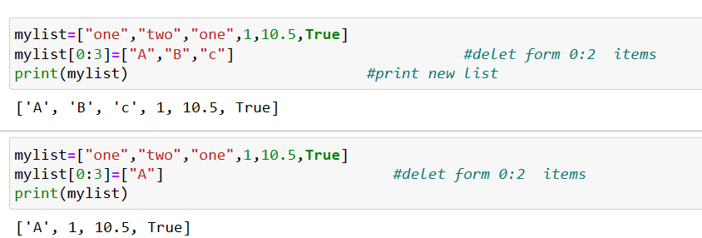
List
List
Edit list item

Slide 26
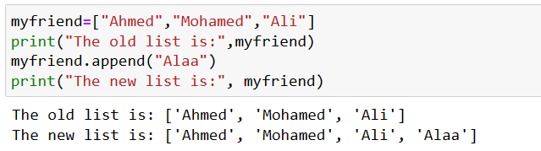
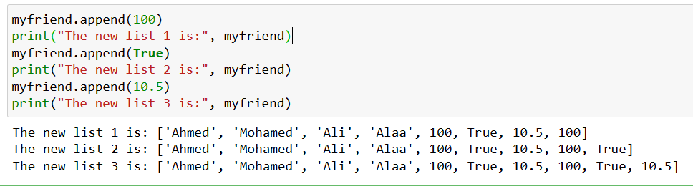
List
List
append() function inserts a single element into an existing list.
The element will be added to the end of the old list

Slide 27
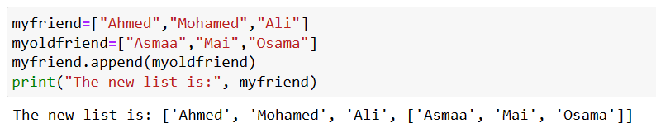
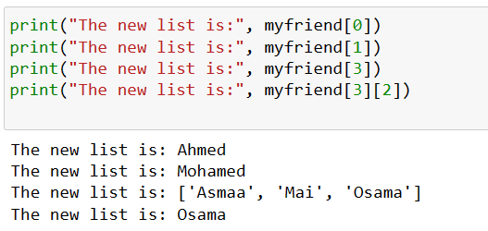
List
Append list to list
Append list to list
It append as a one element
Print item inside list

Slide 28
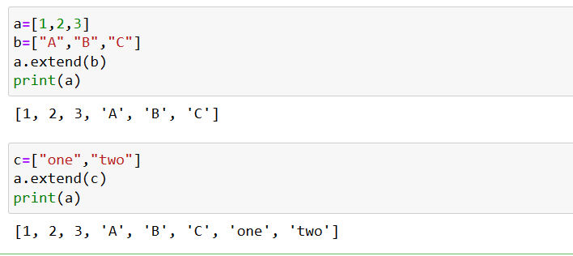
List
extend() method is used to iterate over an iterable (string, tuple, list, set, or dictionary) and then add each element of the iterable to the end of the current list. The length of the list increases by the number of elements present in the iterable.

Slide 29
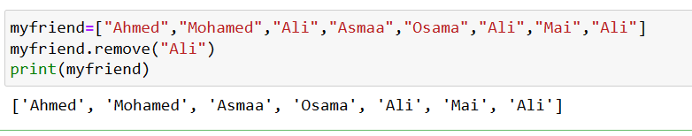
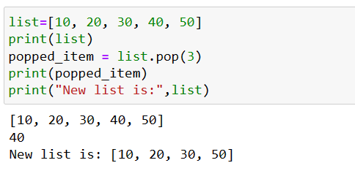
List
In Python, you can remove items (elements) from a list using the clear(), pop(), and remove() methods. It is also possible to delete items using the del statement by specifying a position or range with an index or slice. Additionally, you can utilize list comprehensions to remove items that meet a specific condition.
Remove() method
pop() method

Slide 30
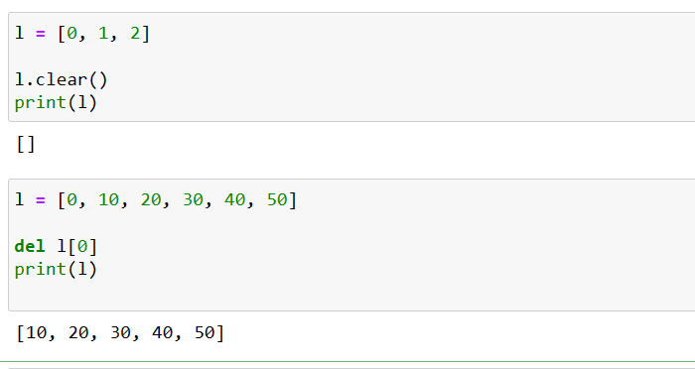

List
clear() method
del() method

Slide 31


List

Slide 32


List
sort () method
Reverse () method
by default, reverse is False
Reversing the list in place means that the method modifies and changes the original list.

Slide 33

List
The copy() method returns a copy of the specified list.

Slide 34



List
index() method helps you find the index position of an element d
count() method returns the number of elements with the specified value.
insert() method inserts the specified value at the specified position.

Slide 35
Tuple
Tuple are enclosed in parentheses
You can remove parentheses if you want
Tuple are ordered, to use index to access item
Tuple are immutable=> you can’t Add, Delete
Tuple items is not unique
Tuple can have different data types

Slide 36


Tuple
You can remove parentheses if you want
Tuple are ordered, to use index to access item

Slide 37

Tuple
Tuple are immutable=> you can’t Add, Delete

Slide 38


Tuple
Tuple items is not unique
Tuple can have different data types

Slide 39


Tuple
Tuple with one element
Python tuple method len() returns the number of elements in the tuple.

Slide 40


Tuple
Repeat the tuple items
Count the tuple items

Slide 41
Thank you
Nashwa Nageh
nashwa.nageh88@gmail.com

